Slide 1
Software Quality Management
Prof. R. Mall
Dept. of CSE, IIT, Kharagpur

Slide 2
Plan of the Talk
Introduction to Quality Engineering.
Quality control and Quality Assurance
ISO 9000
SEI CMM
Summary

Slide 3
Introduction
Traditional definition of quality:
  Fitness of purpose:
    A quality product does exactly what the users want it to do.

Slide 4
Fitness of Purpose
Fitness of purpose for software products:
    Satisfaction of the requirements specified in SRS document.

Slide 5
Quality for Software Products
Consider a software product:
  Functionally correct:
    Performs all functions as specified in the SRS document.
  .

Slide 6
Quality for Software Products
Consider another example:
  A product which does everything that users want.

Slide 7
Modern View of Quality
Several quality factors are associated with a software product :
  Correctness
  Reliability
  Efficiency (includes efficiency of resource utilization)
  Portability
  Usability
  Reusability
  Maintainability

Slide 8
Correctness
A software product is correct:
  If different requirements as specified in the SRS document have been correctly implemented.
  Results are accurate.

Slide 9
Portability
A software product is said to be portable:
  If it can be easily made to work
    In different operating systems.
    In different machines,
    With other software products, etc.

Slide 10
Reusability
A software product has good reusability:
  If different modules of the product can easily be reused to develop new products.

Slide 11
Usability
A software product has good usability:
  If different categories of users (i.e. both expert and novice users) can easily invoke the functions of the product.

Slide 12
Maintainability
A software product is maintainable:
  If errors can be easily corrected as and when they show up,
  New functions can be easily added to the product,
  Functionalities of the product can be easily modified.

Slide 13
Software Quality Management System
Quality management system (or quality system):
  Principal methodology used by organizations to ensure that the products have desired quality.

Slide 14
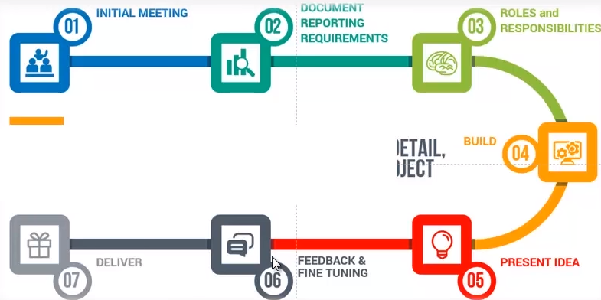

Slide 15
Quality System
A quality system consists of the following:
  Managerial Structure
  Individual Responsibilities.
Responsibility of the organization as a whole.

Slide 16
Quality System
Every quality conscious organization has an independent quality department:
  Performs several quality system activities.
  Needs support of top management.
  Without support at a high level in a company:
    Many employees may not take the quality system seriously.

Slide 17
Quality System Activities
Auditing of projects
Development of:
  standards, procedures, and guidelines.
Production of reports for the top management:
  Summarizing the effectiveness of the quality system in the organization.
Review of the quality system itself.

Slide 18
Quality System
A good quality system must be well documented.
  Without a properly documented quality system, .

Slide 19
Quality System
An undocumented quality system:
  Sends clear messages to the staff about the attitude of the organization towards quality assurance.
International standards such as ISO 9000 provide:
  Guidance on how to organize a quality system.

Slide 20
Evolution of Quality Systems

Slide 21
Evolution of Quality Systems
Initial product inspection method:
  Gave way to quality control (QC).
Quality control:
  Not only detect the defective products and eliminate them
  But also determine the causes behind the defects.

Slide 22
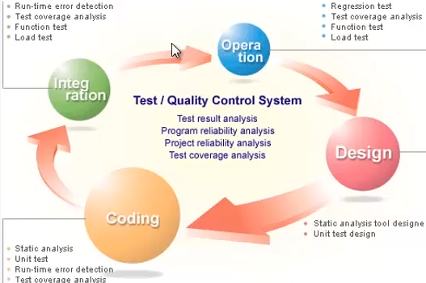

Slide 23
Quality Control (QC)
Quality control aims at correcting the causes of errors:
  Not just rejecting defective products.
Statistical quality control (SQC):
  Quality of the output of the process is inferred using statistical methods.
  In stead of inspection or testing of all products.

Slide 24
Quality Assurance
All modern quality paradigms include:
  Guidance for recognizing, defining, analyzing, and improving the production process.

Slide 25
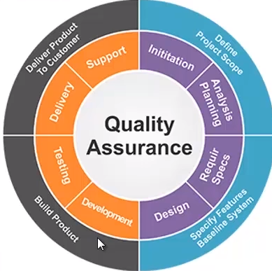

Slide 26
Total Quality Management (TQM)
TQM advocates:
  Continuous process improvements through process measurements.

Slide 27
Process Improvement
Implies introducing process changes to improve:
  Product quality
  Reduce costs
  Accelerate schedules.
Most process improvement work so far has focused on defect reduction.

Slide 28
The Process Improvement Cycle
Measure
Change
Analyse

Slide 29
Process Improvement Stages
Process measurement
  Attributes of the process are measured.
  Form a baseline for assessing improvements.
Process analysis
  The process is assessed and bottlenecks and weaknesses are identified.
Process change
  Changes to the process that have been identified during the analysis are introduced.

Slide 30
ISO 9000
ISO (international Standards Organization):
  Approx. 63 countries established to formulate and foster standardization.
ISO published its 9000 series of standards in 1987.

Slide 31
What is ISO 9000 Certification?
ISO 9000 certification:
  Serves as a reference for contract between independent parties.
The ISO 9000 standard:
  Specifies guidelines for maintaining a quality system.

Slide 32
What is ISO 9000 Certification?
ISO 9000 specifies:
  Guidelines for repeatable and high quality product development.
  Also addresses organizational aspects
    Responsibilities, reporting, procedures, processes, and resources for implementing quality management.

Slide 33
ISO 9000
A set of guidelines for the production process.
  Not directly concerned about the product it self.
  A series of three standards:
    ISO 9001, ISO 9002, and ISO 9003.

Slide 34
ISO 9000
Based on the premise:
  If a proper process is followed for production:
    Good quality products are bound to follow.

Slide 35
How to Get ISO 9000 Certification?
An organization intending to obtain ISO 9000 certification:
  Applies to a ISO 9000 registrar for registration.
ISO 9000 registration process consists of several stages.

Slide 36
How to Get ISO 9000 Certification?
Application stage:
  Applies to a registrar for registration.
Pre-assessment:
  The registrar makes a rough assessment of the organization.

Slide 37
How to Get ISO 9000 Certification?
Document review and adequacy audit:
  Process and quality-related documents.
  The registrar reviews the documents.
  Makes suggestions for improvements.

Slide 38
SEI Capability Maturity Model (CMM)
Developed by Software Engineering Institute (SEI) of the Carnegie Mellon University, USA:
  .

Slide 39
SEI Capability Maturity Model
Can be used in two ways:
  Capability evaluation
  Software process assessment.

Slide 40
Capability Evaluation
Provides a way to assess the software process capability of an organization:
  Helps in selecting a contractor
  Indicates the likely contractor performance.

Slide 41
Software Process Assessment
Used by an organization to assess its current process:
  Suggests ways to improve the process capability.
  This type of assessment is for purely internal use.

Slide 42
SEI Capability Maturity Model
The SEI CMM classifies software development industries into:
  Five maturity levels.
  Stages are ordered so that improvements at one stage provide foundations for the next.

Slide 43
SEI Capability Maturity Model
Optimizing (5)
Managed (4)
Defined (3)
Repeatable (2)
Initial (1)

Slide 44
Level 1: (Initial)
Organization operates
  Without any formalized process or project plans

Slide 45
Level 2: (Repeatable)
Basic project management practices
  Tracking cost, schedule, and functionality are followed.
Size and cost estimation techniques:
  Function point analysis, COCOMO, etc. used.

Slide 46
Level 3: (Defined)
Management and development activities:
  Defined and documented.
  Common organization-wide understanding of activities, roles, and responsibilities.

Slide 47
Level 3: (Defined)
The process though defined:
  Process and product qualities are not measured.
ISO 9001 aims at achieving this level.

Slide 48
Level 4: (Managed)
Quantitative quality goals for products are set.
Software process and product quality are measured:
  The measured values are used to control the product quality.
  Results of measurement used to evaluate project performance:
    Rather than improve process.

Slide 49
Level 4: (Managed)
Organization sets quantitative quality goals.
World-wide about 100 organizations assessed at this level.

Slide 50
Level 5: (Optimizing)
Statistics collected from process and product measurements are analyzed:
  Continuous process improvement based on the measurements.

Slide 51
Level 5: (Optimizing)
Identify best software engineering practices and innovations:
  Tools, methods, or process are identified.
  Transferred throughout the organization.
World-wide about 500 organizations have been assessed at this level.

Slide 52
Difference between ISO & CMM
Sl.No | ISO | CMM
1 | ISO is a generic standard. It is applicable for all industries. | CMM is S/W specific
2 | ISO is a standard. It tells what needs to be done, in an organization. | CMM is a model. It doesn’t mandate the practices
3 | ISO focuses on the entire organization’s processes | CMM is specific to S/W processes
4 | ISO Certification is followed by Surveillance audit once in 6 months | After CMM assessment, there are no such checks. It is upto the organization to use it for internal process improvements
5 | ISO is continuous | CMM is staged (It has different levels of process maturity)
6 | Internal Audits are mandatory | Not mandatory

Slide 53
Personal Software Process (PSP)
A process is the set of steps for doing a job.
The quality and productivity of an engineer
  Largely determined by his process
PSP framework:
  Helps software engineers to measure and improve the way they work.

Slide 54
Personal Software Process (PSP)
Helps developing personal skills and methods.
  Estimating and planning method.
  Shows how to track performance against plans.
  Provides a defined process;
    Recognizes that a process for individual use is different from that necessary for a team project.

Slide 55
PSP-Planning
Problem definition
Estimate max, min, and total LOC
Determine minutes/LOC
Calculate max,min, and total development times
Enter the plan data in project plan summary form
Record the planned time in Log

Slide 56
PSP-Design
Design the program.
Record the design in specified format.
Record the Design time in time recording log.

Slide 57
PSP-Code
Implement the design.
Use a standard format for code text.
Record the coding time in time recording log.

Slide 58
PSP-Compile
Compile the program.
Fix all the defects.
Record compile time in time recording log.

Slide 59
PSP-Test/Postmortem
Test:
  Test the program.
  Fix all the defects found.
  Record testing time in time recording log.
Postmortem:
  Complete project plan summary form with actual time and size data.
  Record postmortem time in time record.

Slide 60
Personal Software Process (PSP)
PSP 3
• Personal process
evolution
PSP 2
• Personal quality management
• Design and code reviews
PSP 1
•Personal planning
• Time and schedule
PSP 0
• Personal measurement
• Basic size measures

Slide 61
Time Management
Track the way you spend time:
  Boring activities seem longer then actual.
  Interesting activities seem short.
Record time for:
  Designing
  Writing code
  Compiling
  Testing

Slide 62
Six Sigma
Six sigma is a quantitative approach to eliminate defects:
  Applicable to all types of industry - from manufacturing, product development, to service.
The statistical representation of Six Sigma quantitatively describes :
  How a process is performing.

Slide 63
Six Sigma
To achieve six sigma:
  A process must not produce more than 3.4 defects per million opportunities.
  5 Sigma -> 230 defects per million.
  4 Sigma -> 6210 defects per million.
Six sigma methodologies:
  DMAIC (Define, Measure, Analyze, Improve, Control).
  DMADV: (Define, Measure, Analyze, Design, Verify).

Slide 64
Six Sigma Methodologies
The methodologies are implemented by Green belt and Black belt workers:
  Supervised by Master black belt worker.
Pareto Chart:
  Simple bar chart to represent defect data
  Identify the problems that occurs with greatest frequency
    or incur the highest cost

Slide 65
Current Trends
Many organizations have already tuned their process for:
  Budget,
  Schedule, and
  Quality product.
Competition is challenging them to:
  Reduce time for delivery
  Adopt Six-Sigma methodology

